Slide 1

Problem Statement : Case Study 1 Vehicle Accident Damage Analysis
HackArena'17
CONFIDENTIAL
October 2017

Slide 2
INTRODUCTION
Currently, in the event of an accident, the customer needs to visit
the insurance company to understand his repair estimation cost. This process is often hectic and time consuming.
The proposed system brings an automated solution to provide the customer with a proper cost estimation of the damage, which eliminates the need for a surveyor to physically come and survey a car.

Slide 3
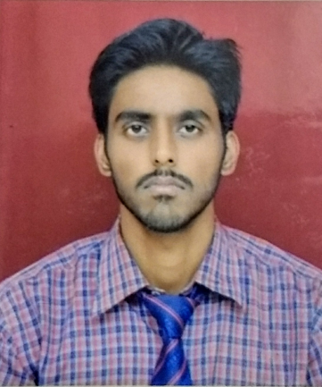
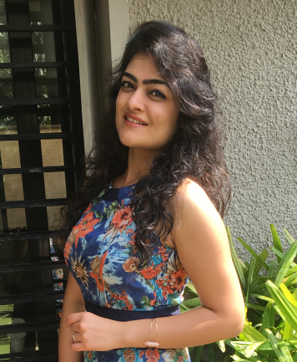



THE BRAINS
Akash Srivastav
Saloni Juneja
Kevin Toms
Bobin Shaji
Anju Mons

Slide 4
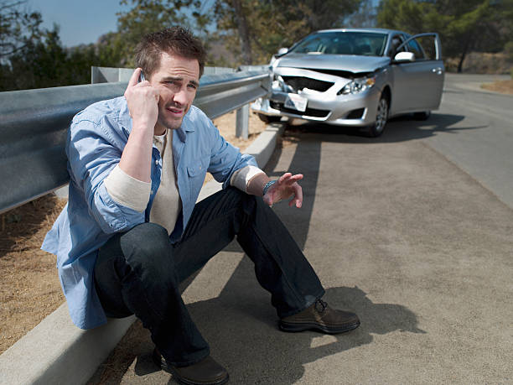
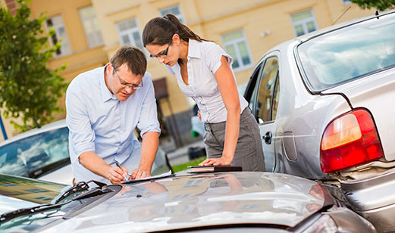
CURRENT CONCERN
Car accidents are stressful and the insurance claim process is highly taxing. A person who’s met with a car accident has to go through a difficult claim process.
He needs to apply his claim with the insurance company, fill a form and submit the application.
The car needs to be taken to the workshop, get an estimate for the damage and provide it to the insurance company. A surveyor is then assigned to verify the cost for repair and he has to physically visit the workshop to do so.
This whole process is time taking and redundant.

Slide 5
SOLUTION DESCRIPTION
The use of machine learning and deep neural networks enables us to train a system to classify the variety and extent of damage to a vehicle through the use of its images. Machine learning combined with Convolution Neural Networks and an incredibly large data set ensures high accuracy of the model. This reduces human effort by a huge factor and digitizes the insurance claim process.
The customer will have to click pictures of the accidental parts of the car and upload it on the mobile app of the insurance company after filling a digital claim form.
Those images will be evaluated by the machine as to what extent the damage can be recovered. This will provide a cost estimation of the damage and that can be reverted to the customer.

Slide 6
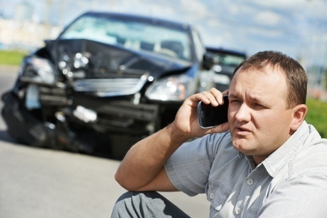
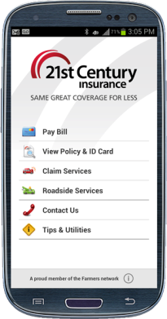
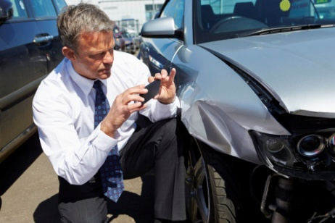

SOLUTION DESCRIPTION CONTD…
The customer’s account details can be securely stored in the databases and the amount estimated by the model can be credited into the customer’s account.
Met with an accident?
Inform the insurance company
Click pictures
Fill the online form on the company’s app
Upload pictures
Wait for reimbursement

Slide 7
NOVELTY FACTOR
The solution that we are proposing is currently not in the market, therefore the project as a whole is novel.
The use of machine learning to process the image and provide a cost estimate
Eliminating the need for a physical survey
Digital claim forms
Quick online reimbursement

Slide 8

BUSINESS IMPACT
The provided solution quickens the reimbursement process
A separate physical survey isn’t required by the surveyor. The workshop can communicate to the insurance company
This solution will attract more customers and hence increase the business for the insurance company that deploys this model

Slide 9
ANY EXISTING SIMILAR SOLUTIONS?
Similar solutions are being worked upon by few companies although none are currently in effect in the market.
Google APIs for use of machine learning in identifying cars is available for public use

Slide 10
Thank You

